Slide 1
Run And Gun
By Finn Dudley

Slide 2
Gameplay
The Gameplay:
A top-down shooter “zombie” game, where waves of enemies spawn and try to kill the player, and the player has to fight them off with an assortment of weapons. The playable map of the game can be chosen from the menu with multiple different choices in size.
The Aim:
To survive as many waves as possible from the “zombies” which becomes increasing harder with a greater number of them spawning on each wave.

Slide 3
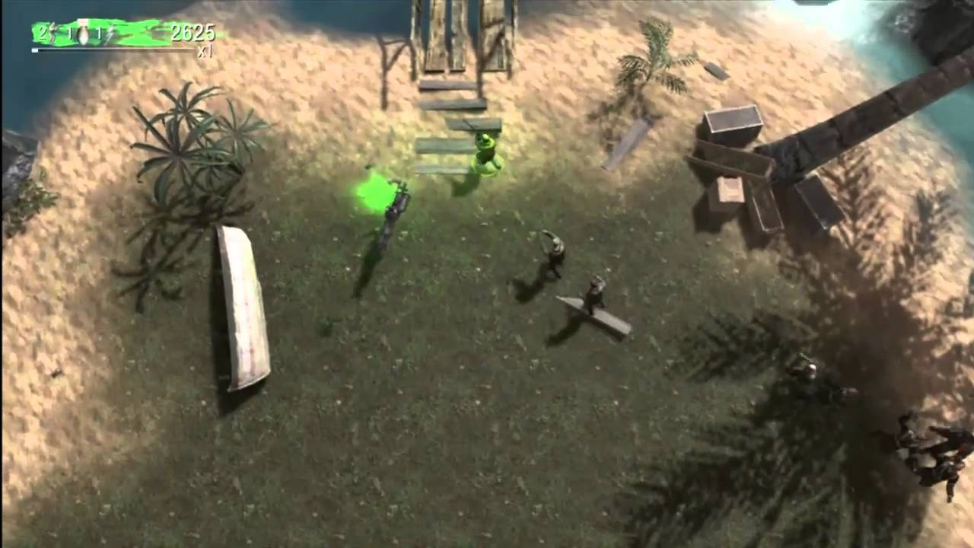
Gameplay
Similar in gameplay to the Call of Duty: Zombies' Dead Ops map, which was a more arcade style to a zombies game (Figure 1).
Figure 1: Call Of Duty: Zombies’ Dead Ops Gameplay

Slide 4
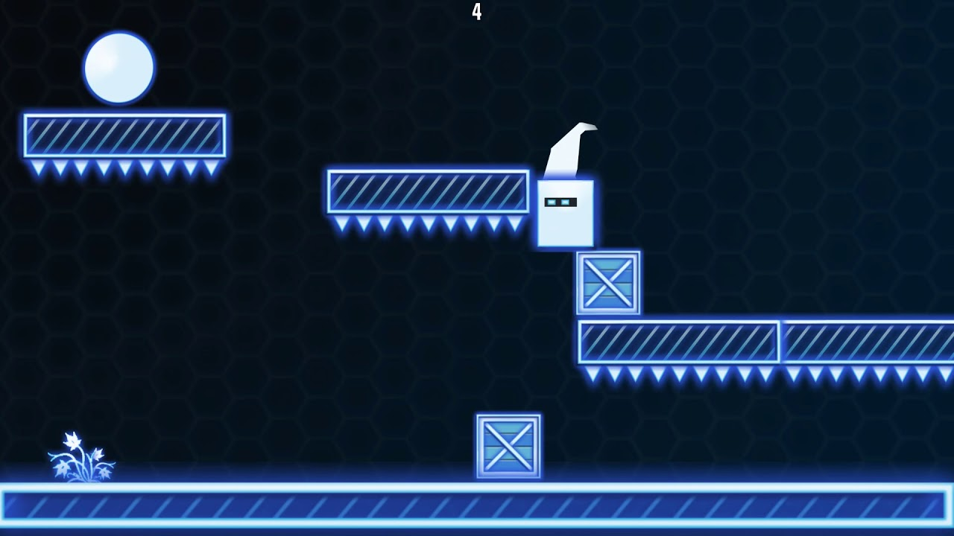
Game Aesthetic
The overall aesthetic of the game is futuristic. With game assets being along the neon style visually (Figure 2).
Figure 2: 2D Neon Cube Gameplay

Slide 5
Game Mechanics
Weapons Swapping:
The ability to smoothly swap between 2-3 weapons (pistol, shotgun, machine gun) with each weapon having their own ammo size, firerate and shot size, with each gun reloading when put away (emphasising weapons swapping).
User Input:
Aiming the gun with the mouse that is positioned around the player and clicking to shoot the selected weapon.
Waves of Enemies:
Waves of “zombie” like enemies spawn with increasing amounts each wave, that spawn from set locations over the wave, until they are all dead, which enables the next wave.

